Slide 1
Hibernia College Onsite Tutorial
Sessions 9 and 10

Slide 2
Session 10 Matrices and Linear Equations
Matrices
Basic Matrix Operations
Scalar multiplication
Addition
Subtraction
Dimensions of a Matrix
Matrix Multiplication
Identity Matrix I

Slide 3
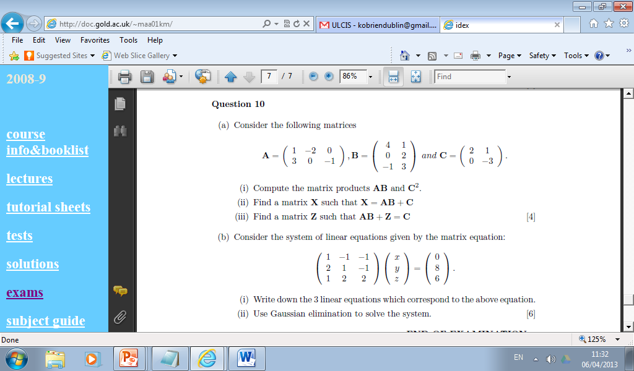

Slide 4
Session 10 Matrices and Linear Equations
Systems of Linear Equations
Using Matrices in Calculations
Augmented Matrices
Elementary Row Operations
Reduced Row form
Solutions for Systems

Slide 5
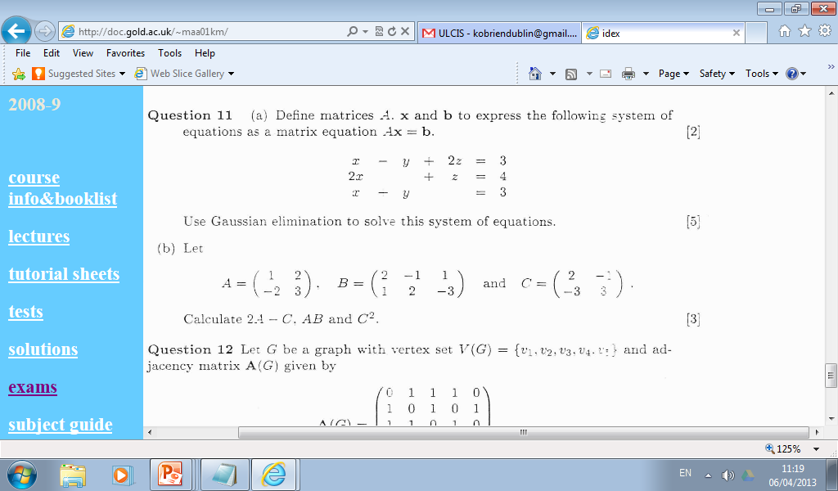

Slide 6
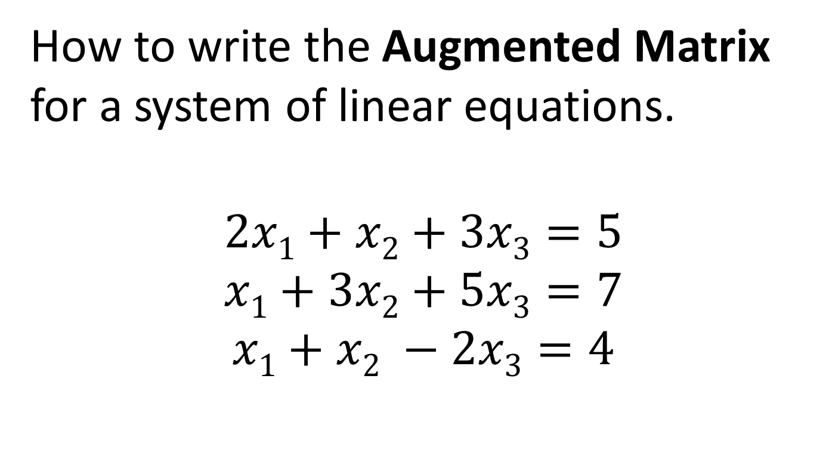
Augmented Matrix
How to write the Augmented Matrix for a system of linear equations.
$$\begin{matrix}2x1+x2+3x3=5 \\ x1+3x2+5x3=7 \\ x1+x2 −2x3=4\end{matrix}$$

Slide 7
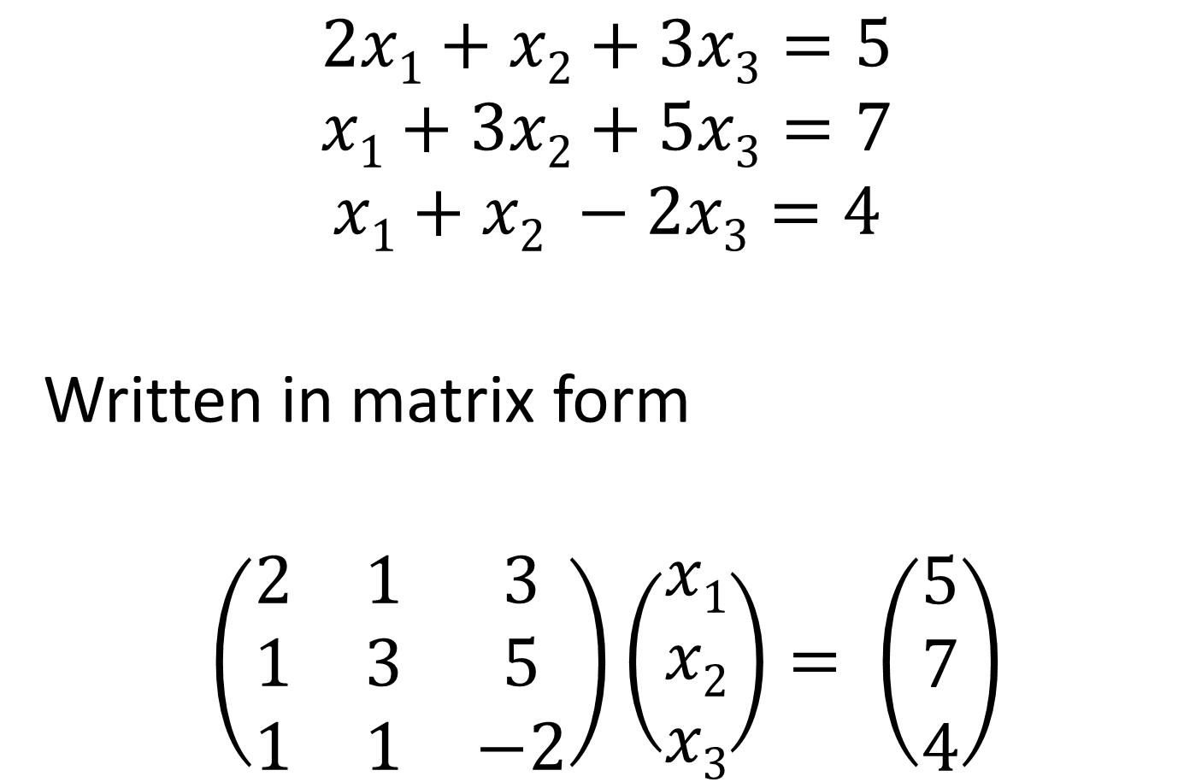
$$\begin{matrix}2x1+x2+3x3=5 \\ x1+3x2+5x3=7 \\ x1+x2 −2x3=4\end{matrix}$$
Written in matrix form
$$\left(\begin{matrix}2 & 1 & 3 \\ 1 & 3 & 5 \\ 1 & 1 & −2\end{matrix}\right)\left(\begin{matrix}x1 \\ x2 \\ x3\end{matrix}\right)= \left(\begin{matrix}5 \\ 7 \\ 4\end{matrix}\right)$$

Slide 8

$$\left(\begin{matrix}2 & 1 & 3 \\ 1 & 3 & 5 \\ 1 & 1 & −2\end{matrix}\right)\left(\begin{matrix}x1 \\ x2 \\ x3\end{matrix}\right)= \left(\begin{matrix}5 \\ 7 \\ 4\end{matrix}\right)$$
$$\left(\begin{matrix}2 & 1 & 3 \\ 1 & 3 & 5 \\ 1 & 1 & −2\end{matrix} \begin{matrix}⋮ & 5 \\ ⋮ & 7 \\ ⋮ & 4\end{matrix}\right)$$

Slide 9
Elementary Row Operations
(Operations are performed on rows only. Never perform any of these operations on columns.)
Multiply a row by a constant value
Switch the position of two rows
Add two rows together
Subtract one row from another.
Finish when matrix is in reduced echelon form

